Slide 1
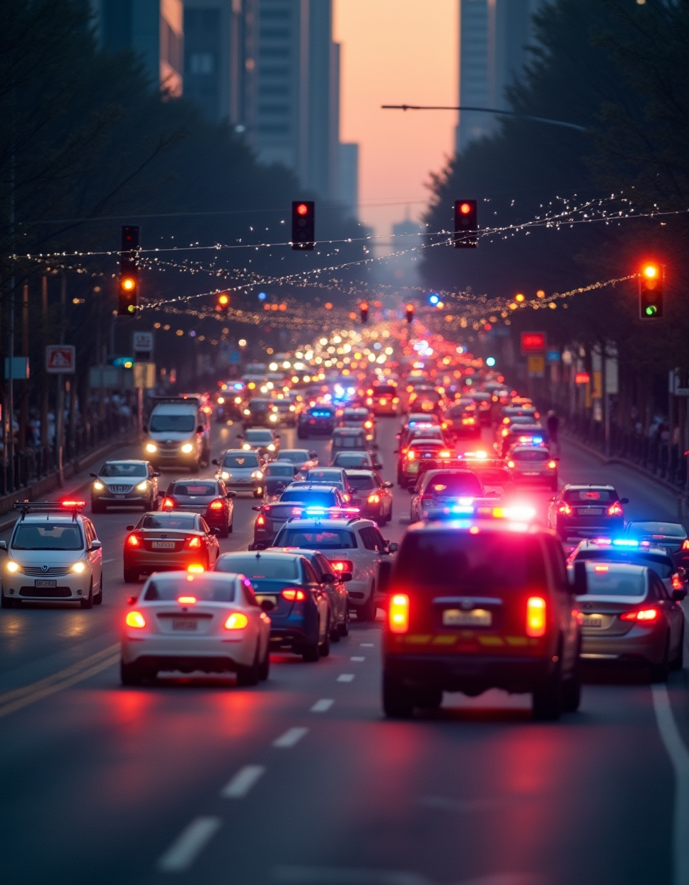
Neuro-Adaptive Route Planning for Emergency Vehicles
Enhancing Emergency Response Through Innovative AI Solutions

Slide 2

Introduction
This presentation outlines the need for a neuro-adaptive route planning system designed to improve emergency vehicle response times. It discusses the critical problem of traffic delays, presents an innovative AI solution, and explores core features and expected outcomes that prioritize public safety and efficiency in emergency situations.

Slide 3
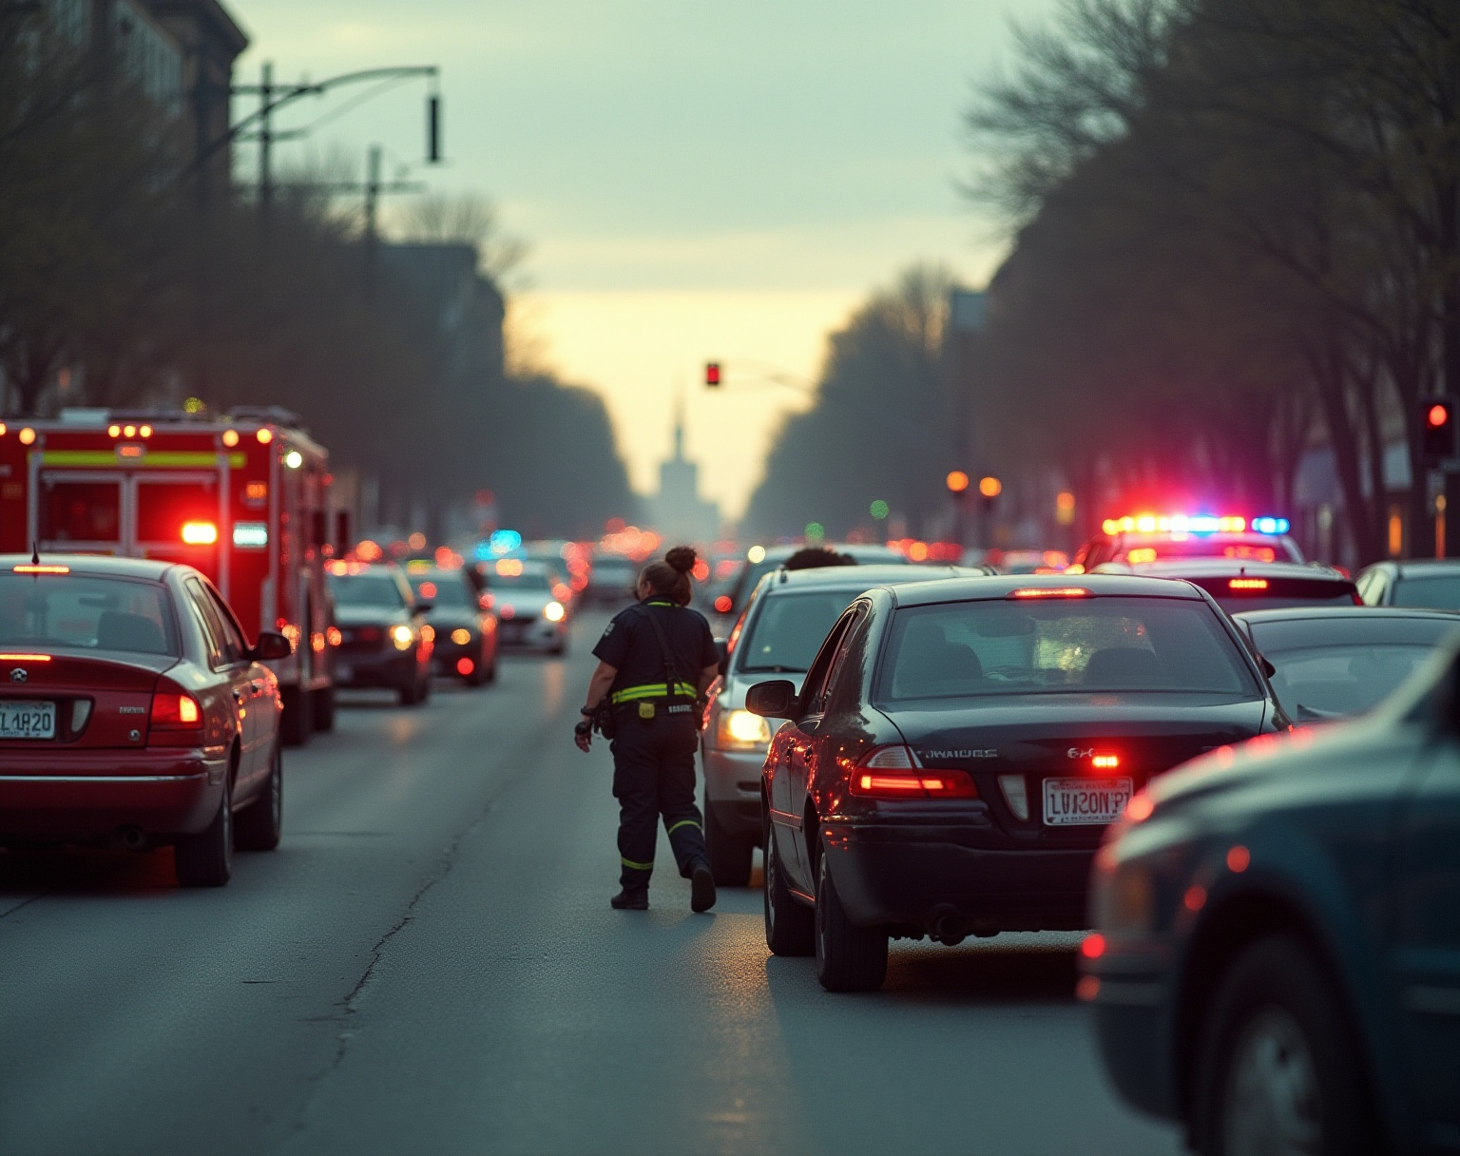
01
Problem Statement & Proposed Solution

Slide 4
Traffic Delays Impacting Emergency Response
Emergency vehicles like ambulances and fire trucks often experience significant delays due to traffic congestion and ineffective coordination. These delays can lead to life-threatening situations, reduced public trust, and escalated emergencies. Addressing these challenges requires a comprehensive solution that enhances real-time navigation to improve response times.

Slide 5
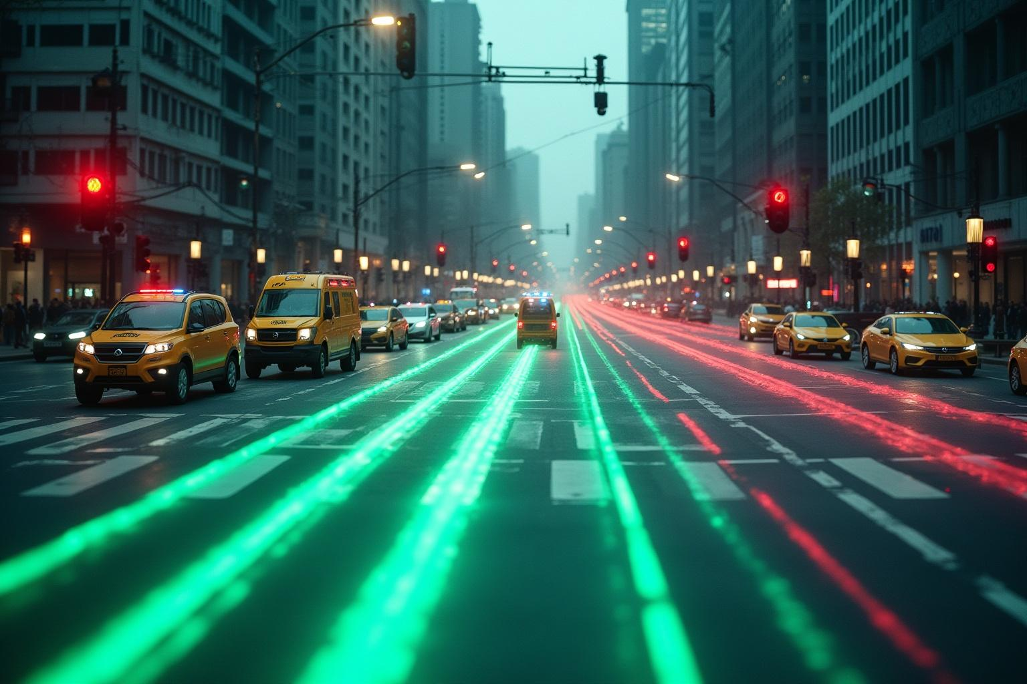
AI-Powered Neuro-Adaptive System Overview
The proposed solution involves developing an AI-powered neuro-adaptive system that optimizes emergency vehicle routes. This includes controlling traffic signals in real-time to create “green corridors” and rerouting nearby vehicles through V2V and V2I communication. The system aims to prioritize road space and predict traffic patterns to ensure swift passage for emergency responders.

Slide 6
Real-Time Route Optimization & Traffic Control
The neuro-adaptive system utilizes AI neural networks to predict congestion and dynamically select the fastest and safest routes for emergency vehicles. Additionally, it implements adaptive traffic signal control, ensuring that signals along the emergency route turn green automatically. This integration effectively minimizes delays and enhances the efficiency of emergency response.

Slide 7

02
Core Features & Technologies

Slide 8
Key Features of the Proposed System
Key features include real-time route optimization, adaptive traffic signal control, and vehicle rerouting capabilities. The system uses AI to detect obstacles and incidents in real-time, allowing for instant replanning of routes. Moreover, it coordinates multiple emergency vehicles to avoid conflicts, ensuring an efficient emergency response strategy.

Slide 9
Technologies Employed in Development
The project relies on advanced technologies such as Deep Reinforcement Learning for decision-making and IoT sensors paired with traffic cameras for real-time data. V2X communication enables vehicle-to-infrastructure coordination, while cloud and edge AI support rapid computations. This robust tech stack enhances the system’s effectiveness in managing emergency routes.

Slide 10
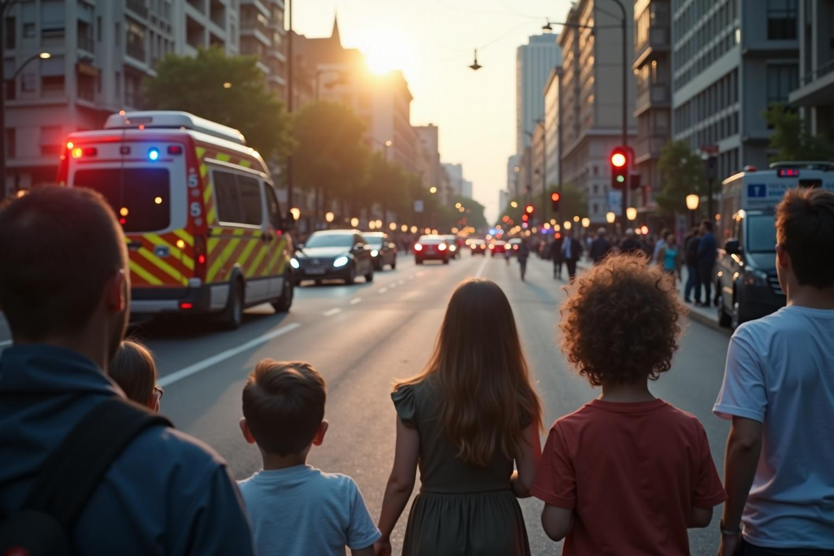
Expected Outcomes for Public Safety
The implementation of this neuro-adaptive route planning system is expected to significantly reduce response times for emergency vehicles, create dynamic green corridors, and improve overall public safety. Additionally, it will serve as a foundational element for smart city emergency management systems, enhancing urban mobility and trust in public safety services.

Slide 11
Conclusions
In conclusion, the neuro-adaptive route planning system represents a transformative approach to enhancing emergency vehicle response times. By harnessing AI technologies and effective traffic management strategies, we can save lives and improve public safety. The proposed system not only optimizes routes but also establishes a framework for future smart city initiatives.

Slide 12
Thank you!
Do you have any questions?
+00 000 000 000

